Slide 1
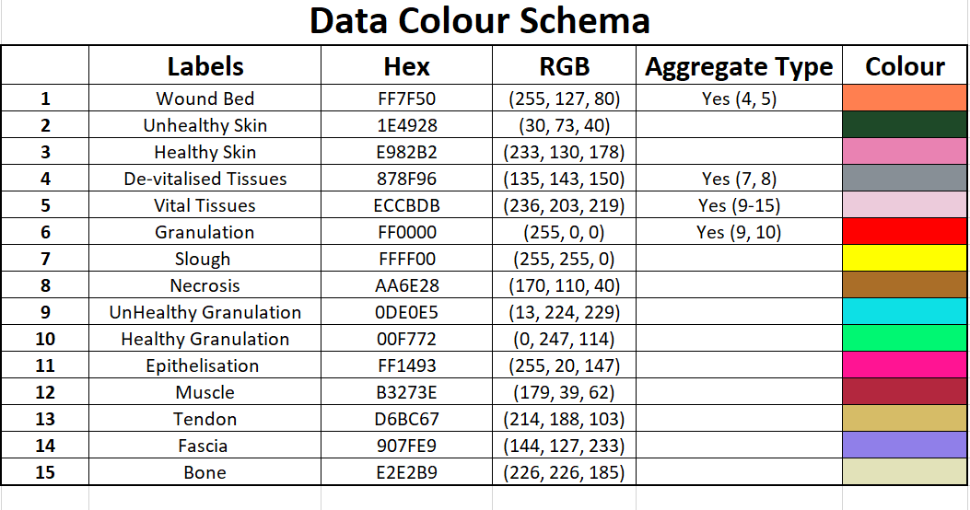

Slide 2
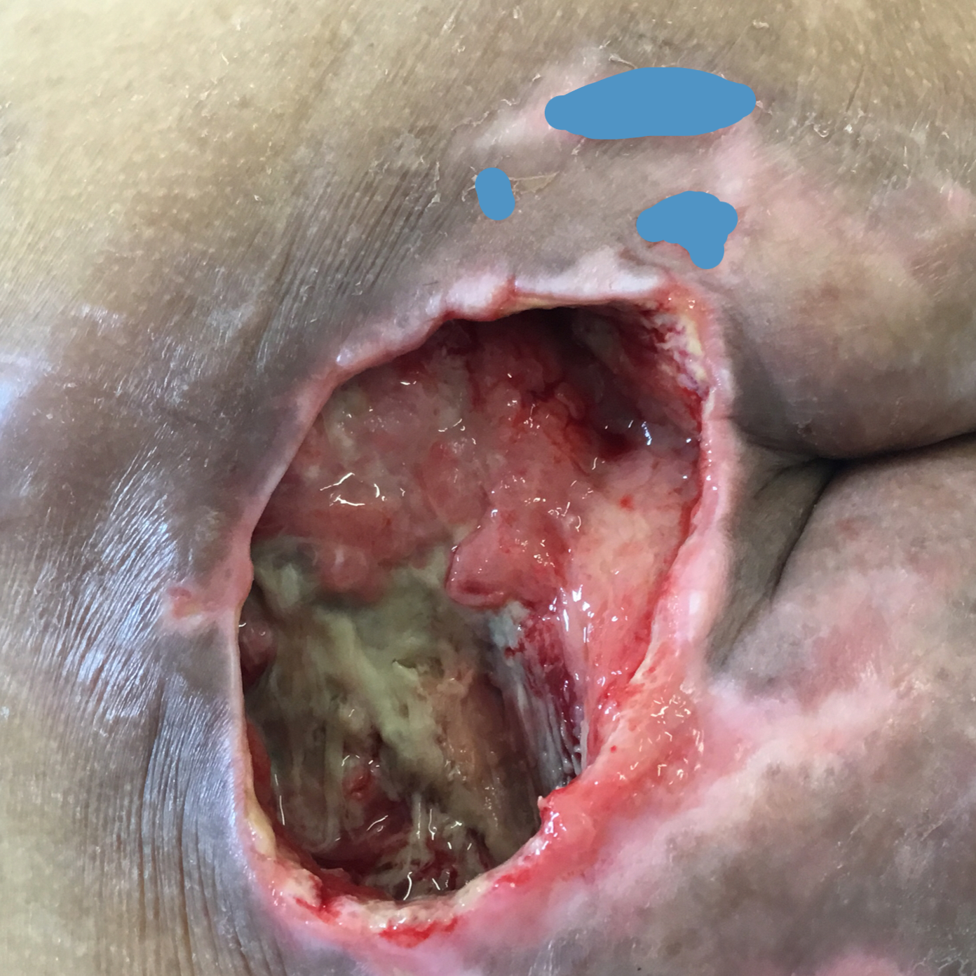
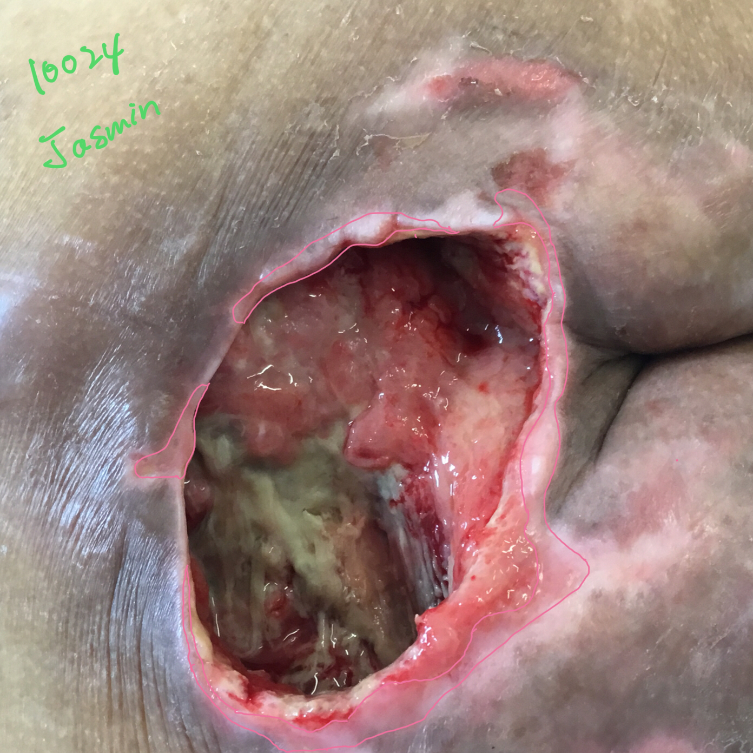
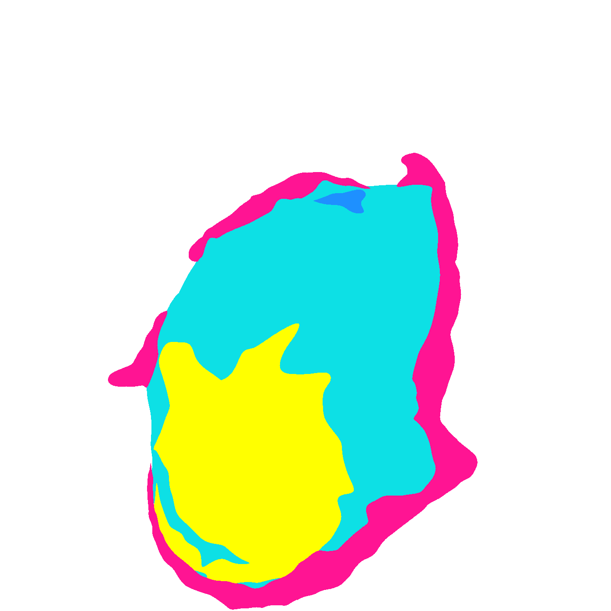
Original Wound Img
Latest Annotation
Original Mask
Metadata Wound Location: Buttock Wound Type:

Slide 3

texture does not look like slough but not too sure
Notes:
It is previously adipose tissue but now slough already. The original tissue is dense thats why it presents with this kind of concentrated image. The texture however you can see is liquified. Thats what makes it slough.

Slide 4
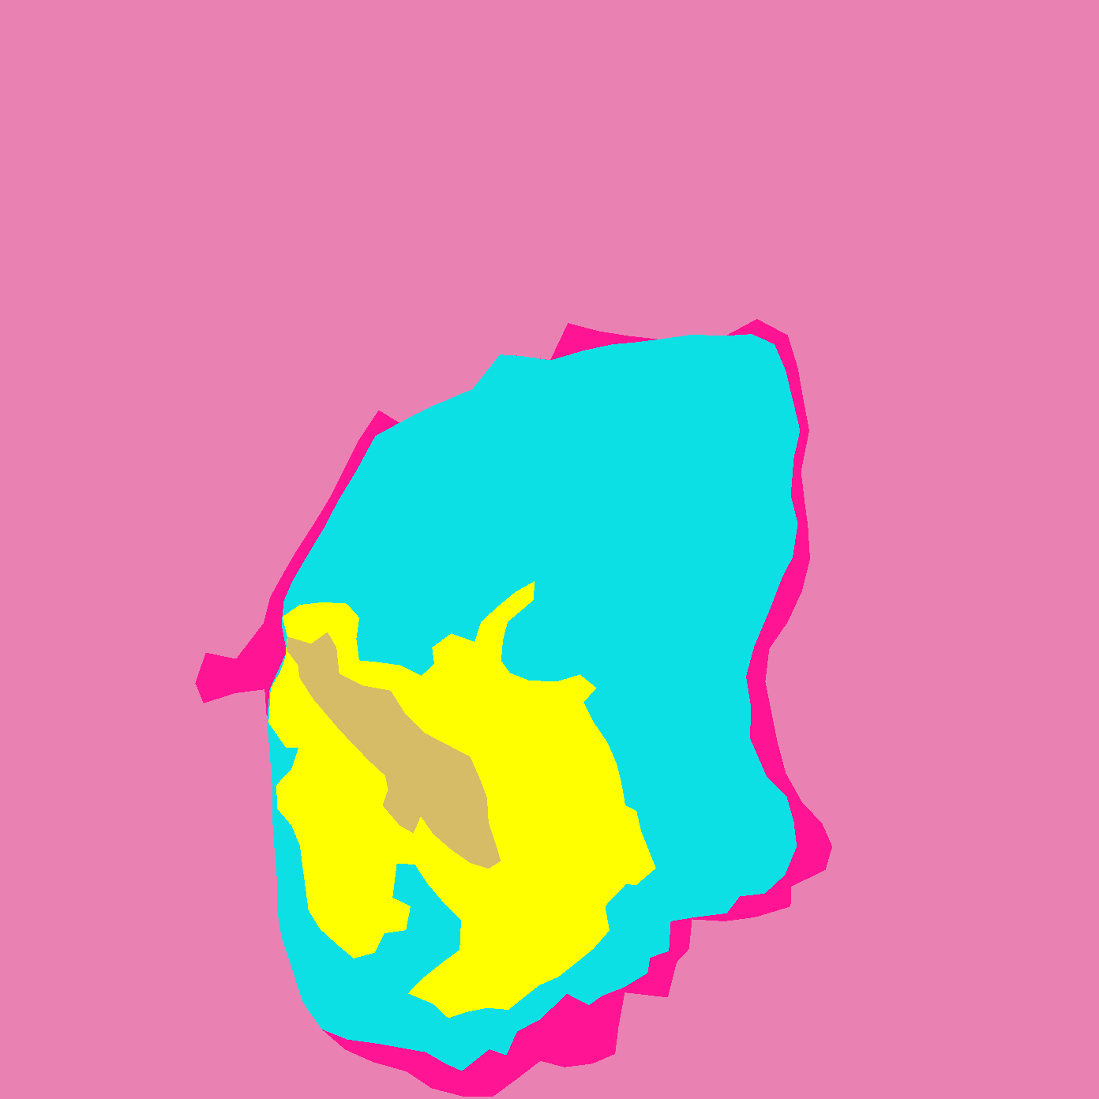
Original Wound Img
New Mask
Original Mask

Slide 5
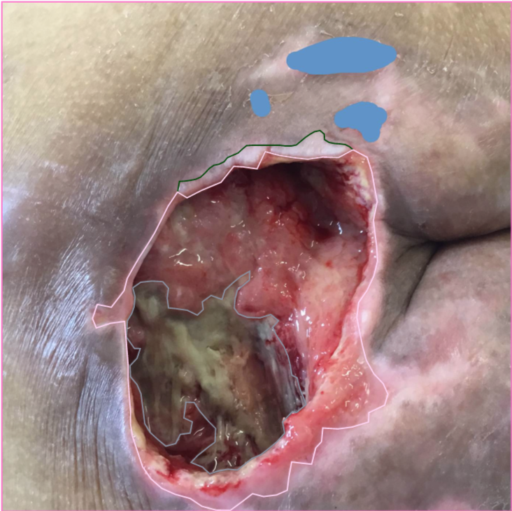
Notes:
Maceration - unhealthy skin

Slide 6
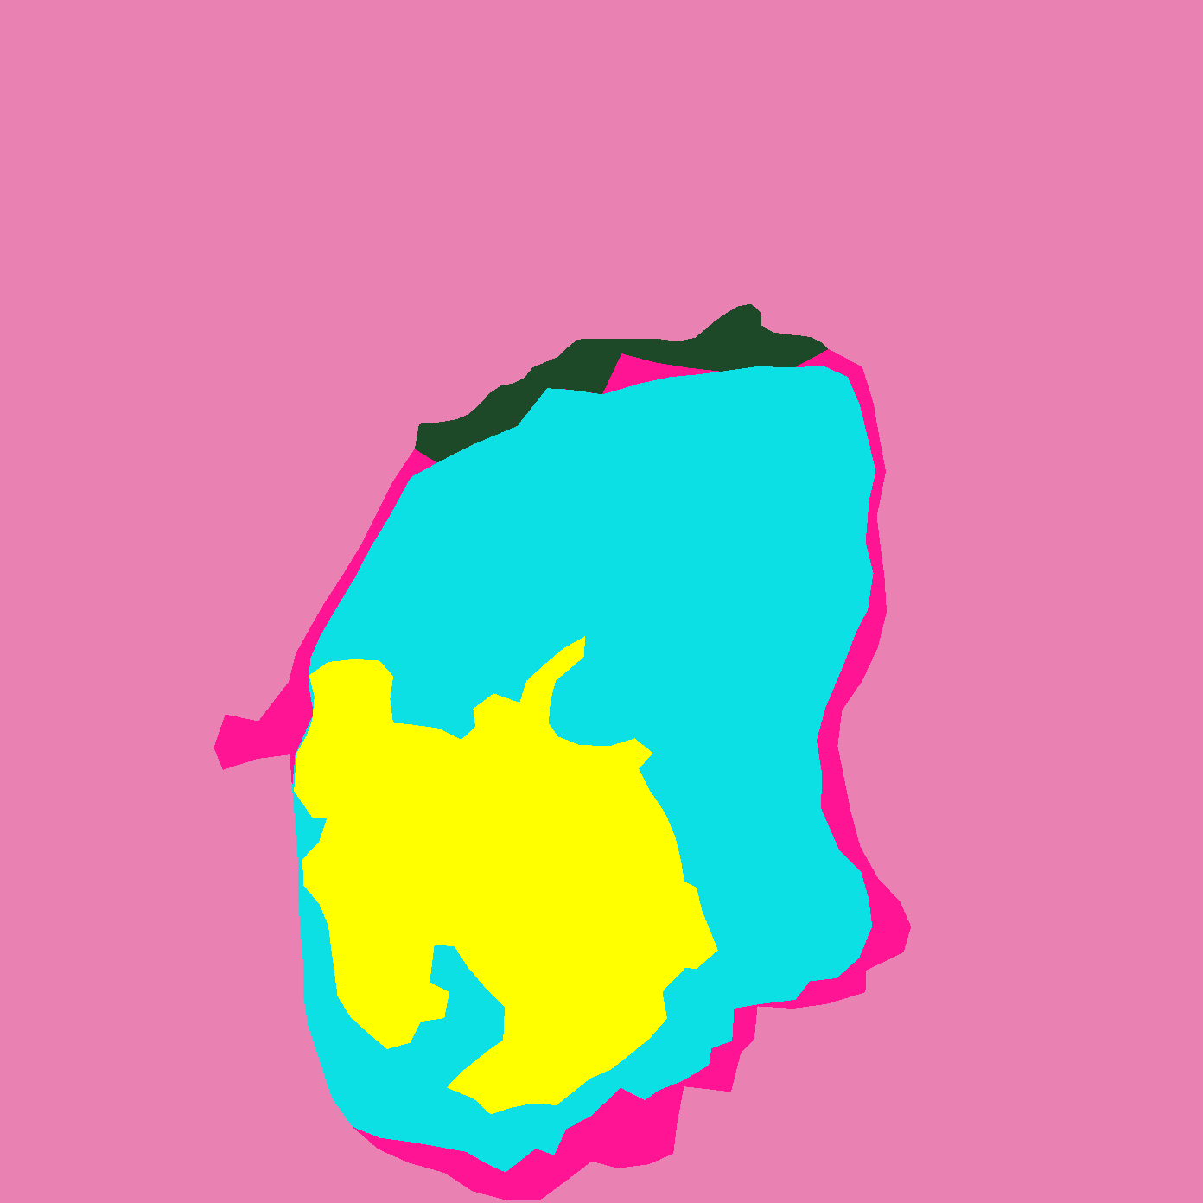
SD: Accepted

